Slide 1

Project Prototype
Jonathan Baird

Slide 2
Front Page
Contains the ability to login or register if the user isn’t already logged in.
If logged in then it gives links to their profile and the post creation page
The rest of the page shows posts and their comments. If logged in then a comment box is shown.
If logged in, every page has a logout button

Slide 3
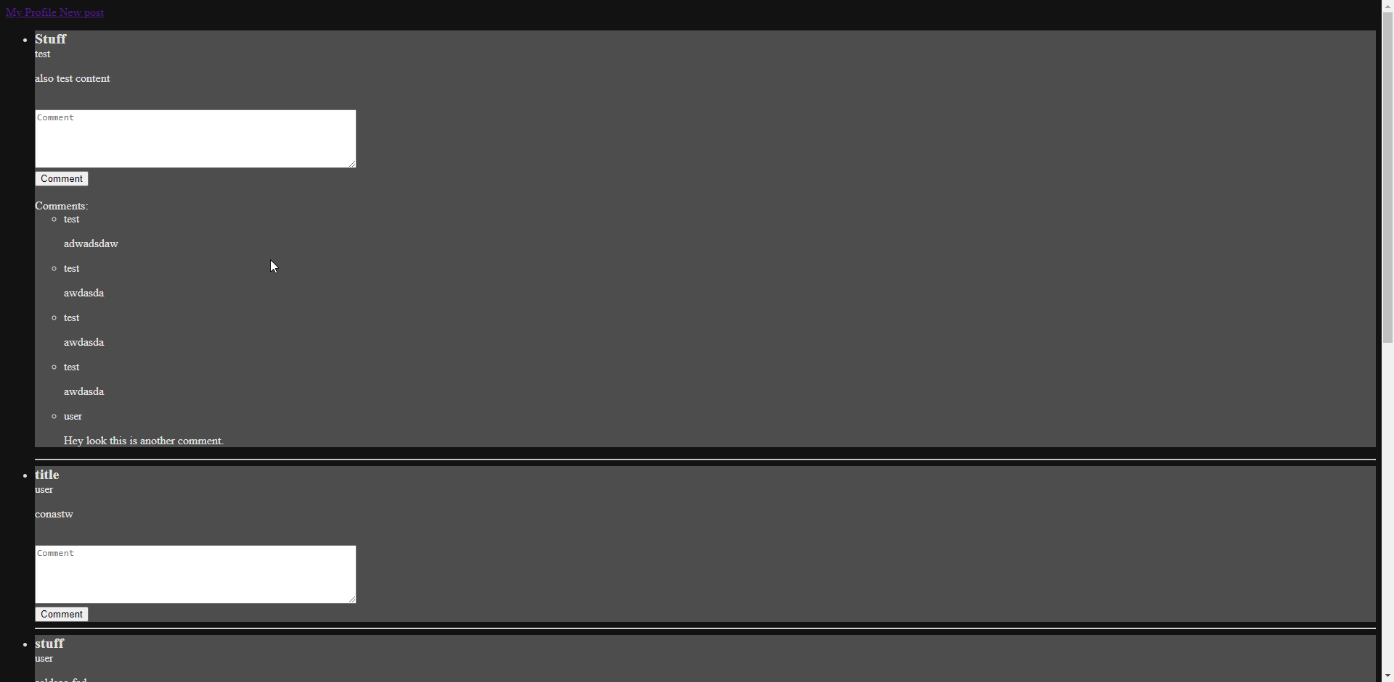
Front Page Logged In

Slide 4
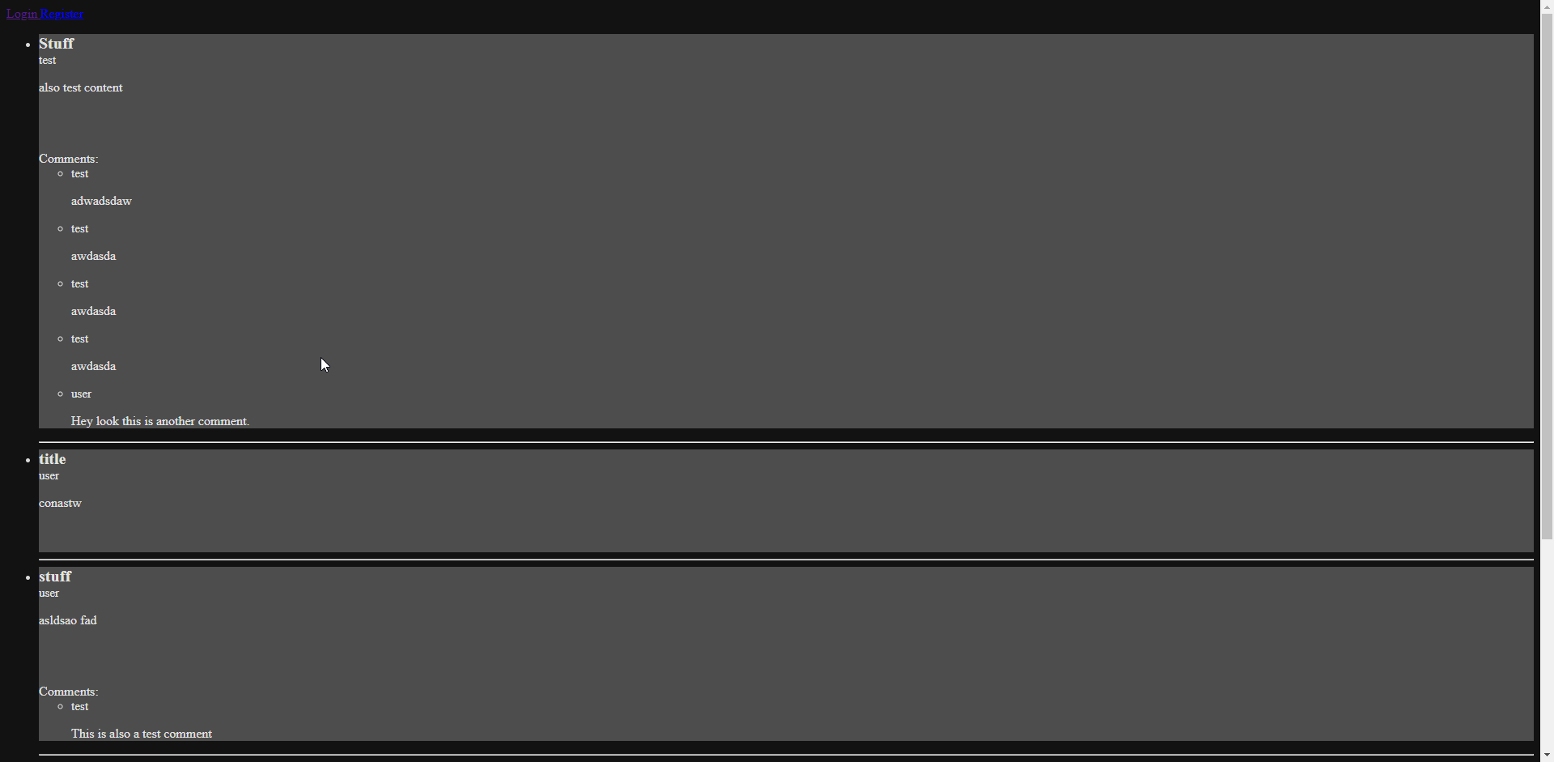
Front Page Logged Out

Slide 5
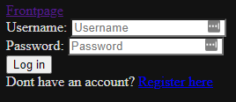
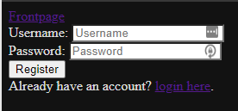
Login and Register Pages
Simple login and register pages, once logged in it takes you straight to your profile page.

Slide 6
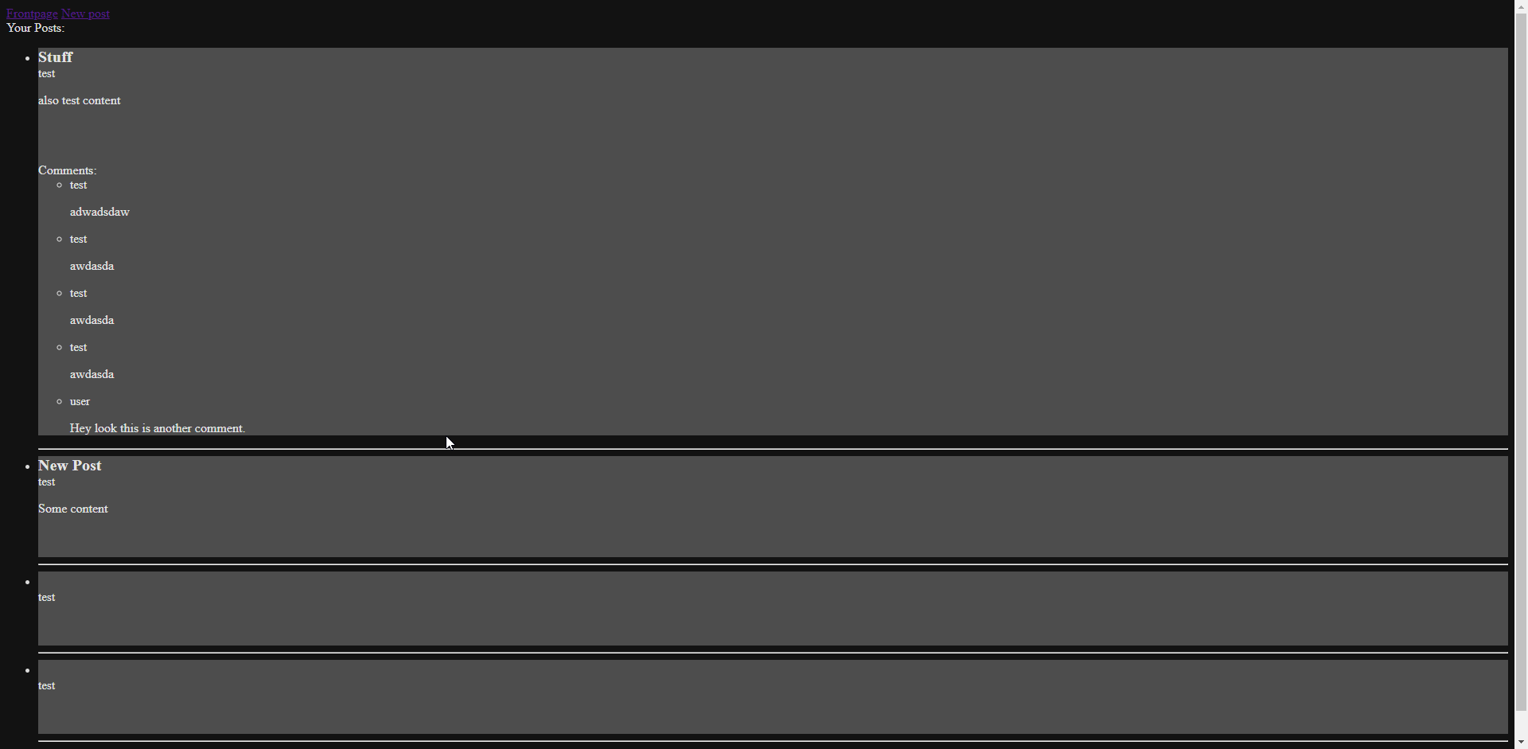
Profile Page
Only accessible if logged in
Displays all your posts and their comments.

Slide 7
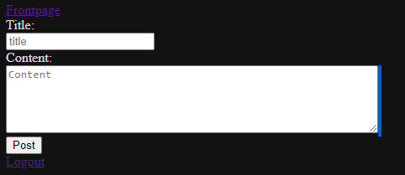
New Post Page
Only viewable if logged in.
Creates a post in the database that will then be displayed on the front page.

Slide 8
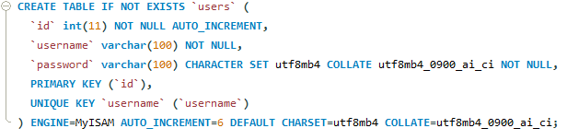
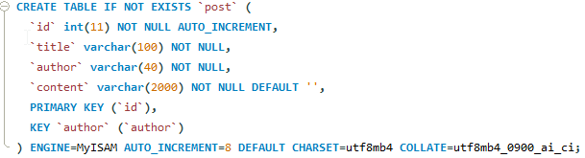
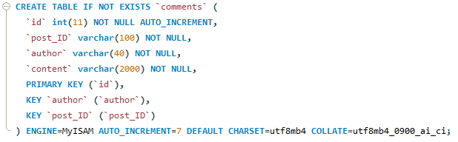
Database Schema, Hosted on AWS

